Slide 1
计算机视觉 Computer Vision
-- Matching 1
钟 凡
zhongfan@sdu.edu.cn

Slide 2
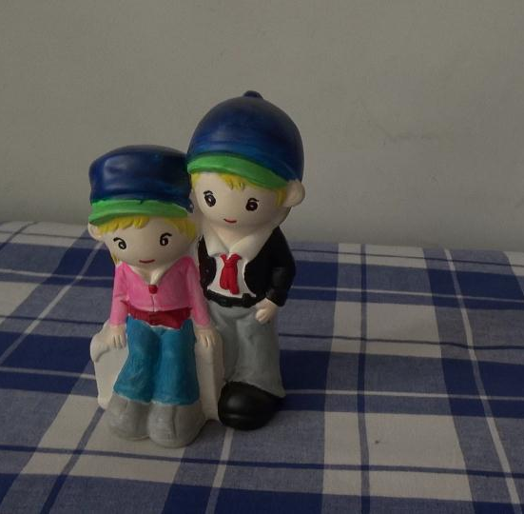
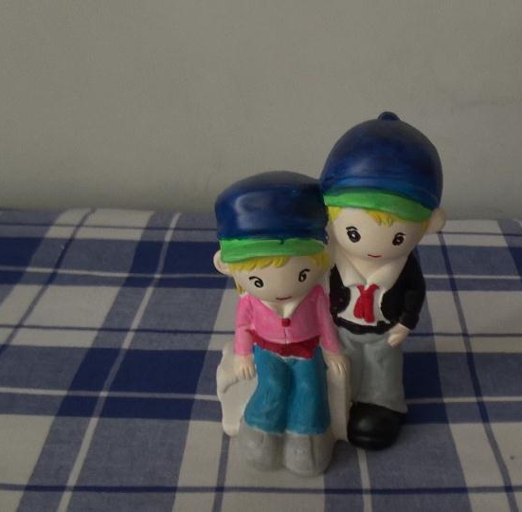
图像匹配
同一场景点在不同图像之间像素的对应关系
同一视频中两帧

Slide 3
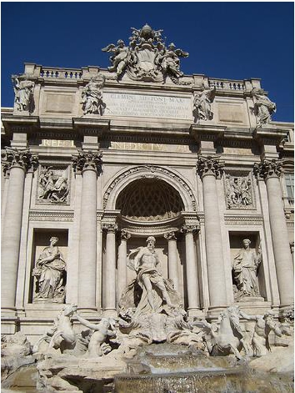
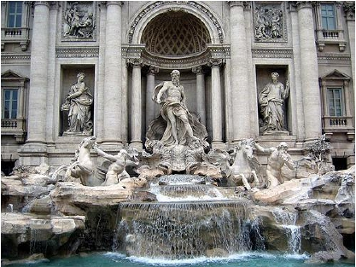
图像匹配
不同人拍摄的同一场景

Slide 4
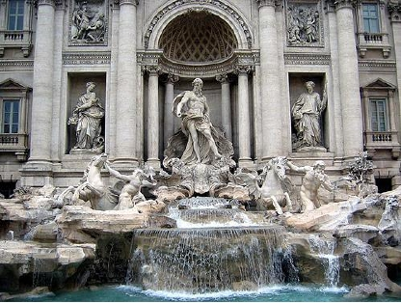
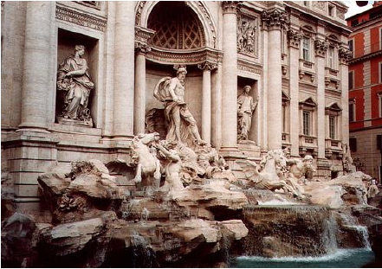
图像匹配
同一场景的不同角度

Slide 5
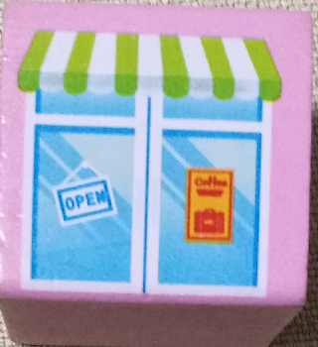
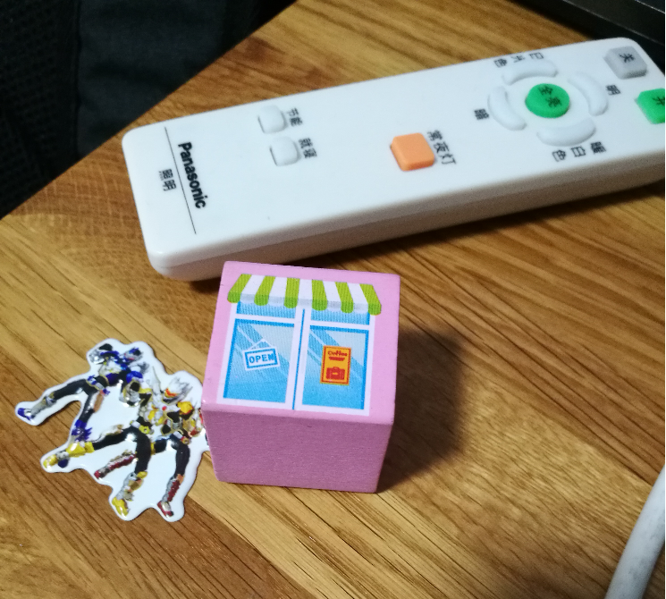
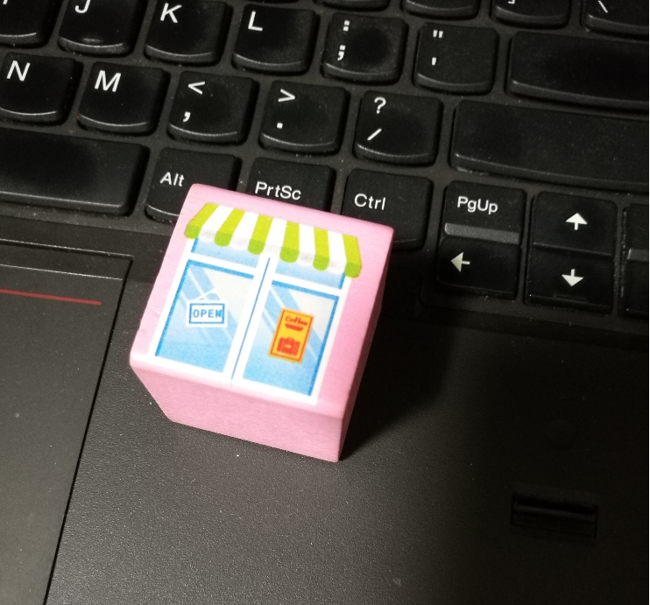
图像匹配
同一物体，不同场景

Slide 6
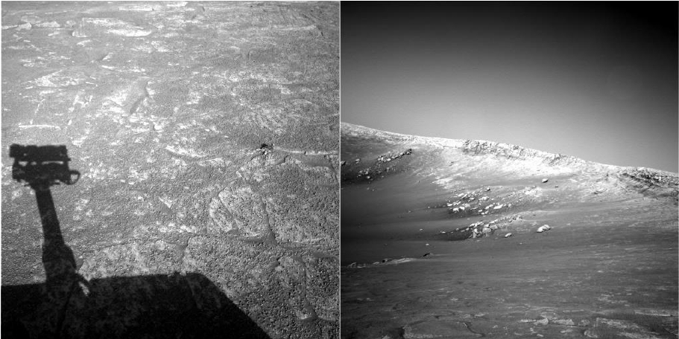
??

Slide 7
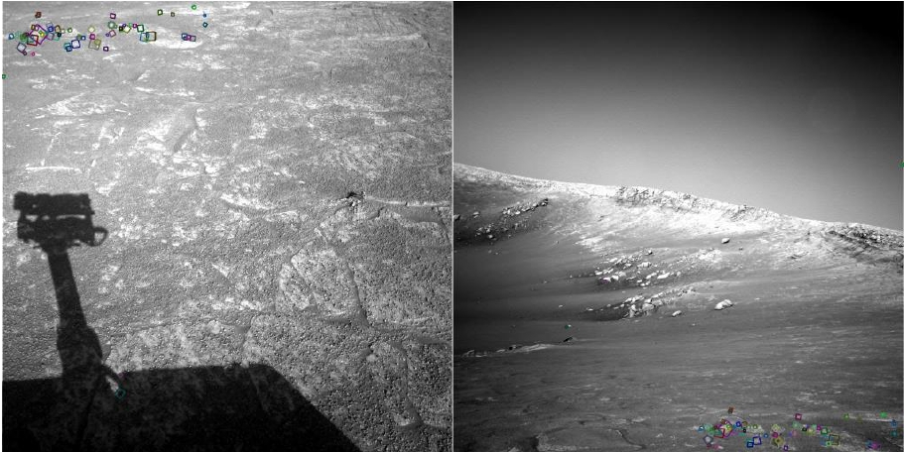
!!

Slide 8
意义
视频处理与分析的基础
视觉三维重建的基础
早期物体识别、图像检索技术的基础
……
计算机视觉半壁江山的基础

Slide 9
你会怎么办？

Slide 10
局部特征

Slide 11
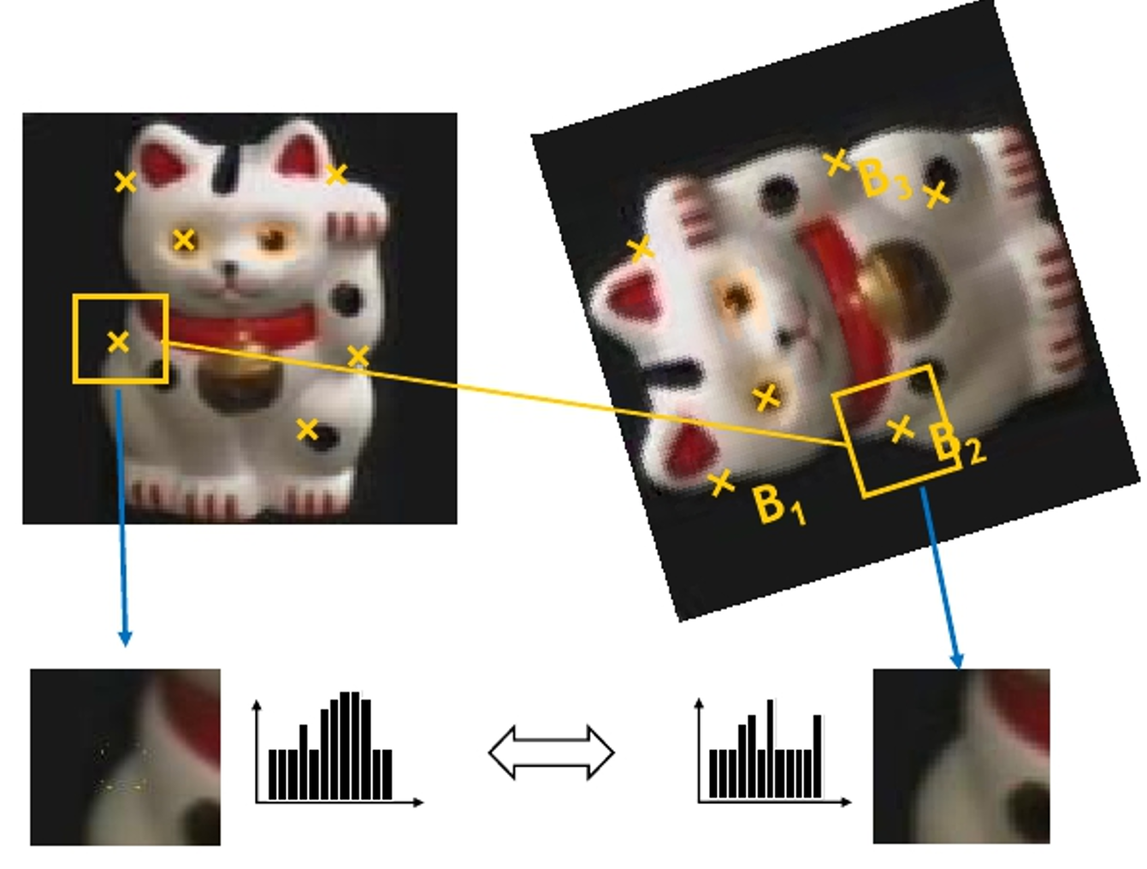

Slide 12
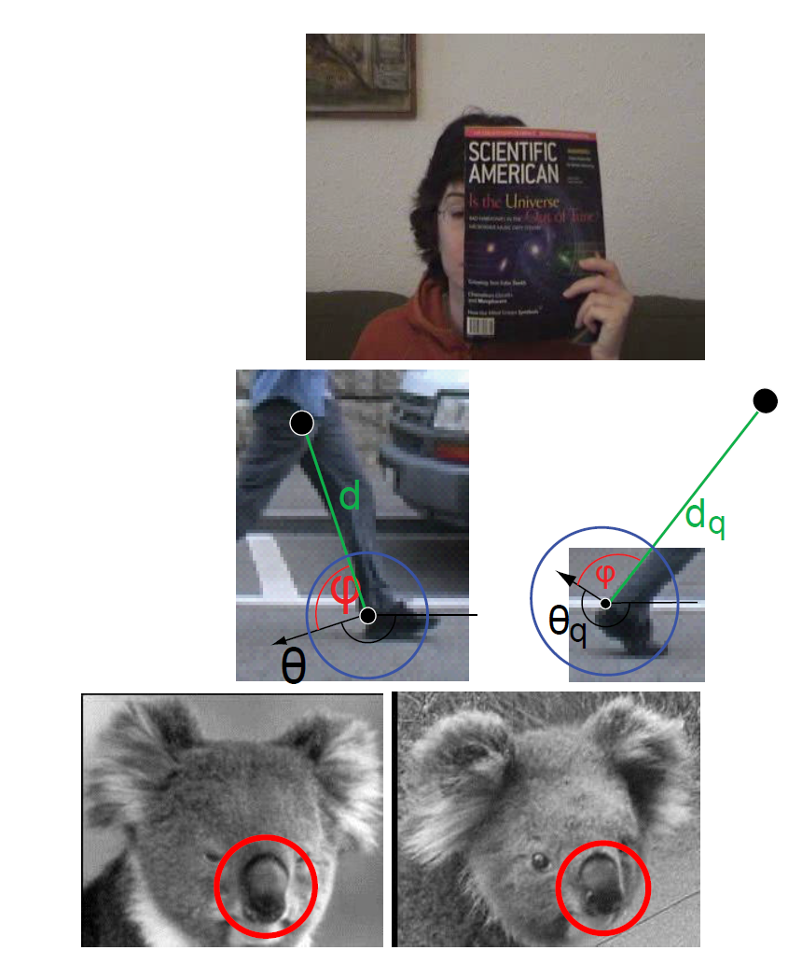
为什么要“局部”？
全局特征面临以下情况时会面临难以克服的困难：
遮挡
形变
环境变化

Slide 13
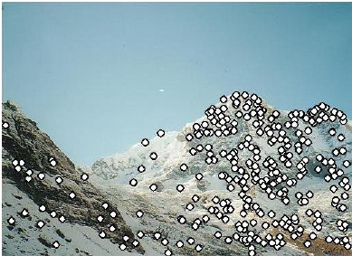
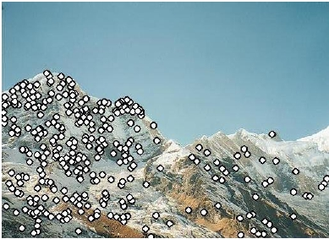
1. 特征检测

Slide 14
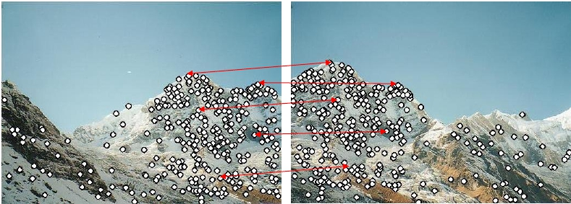
2. 特征匹配

Slide 15

3. 运动估计

Slide 16
特征检测

Slide 17
特征点
什么样的点才应该是特征点？

Slide 18
特征点
目标1：稳定检测

Slide 19
特征点
目标2：易于匹配

Slide 20
特征检测与匹配
挑战1：对图像几何变换的稳定性

Slide 21
特征检测与匹配
挑战1：对图像几何变换的稳定性

Slide 22
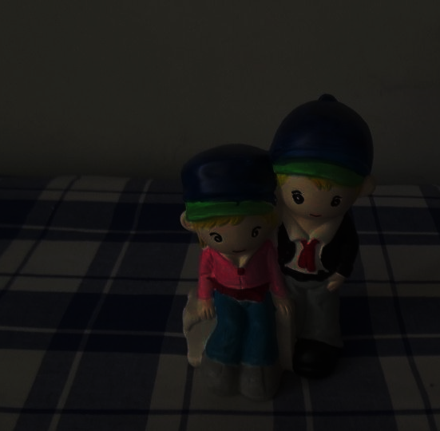
特征检测与匹配
挑战2：对颜色、光照变化的稳定性

Slide 23

Requirements
• Region extraction needs to be repeatable and accurate
➢
➢
➢
Invariant to translation, rotation, scale changes
Robust or covariant to out-of-plane (≈affine) transformations
Robust to lighting variations, noise, blur, quantization
• Locality: Features are local, therefore robust to
occlusion and clutter.
• Quantity: We need a sufficient number of regions to
cover the object.
• Distinctiveness: The regions should contain
“interesting” structure.
• Efficiency: Close to real-time performance.
Sensory Augmented Computing Computer Vision
WS 14/15
Perceptual and
30
B. Leibe

Slide 24
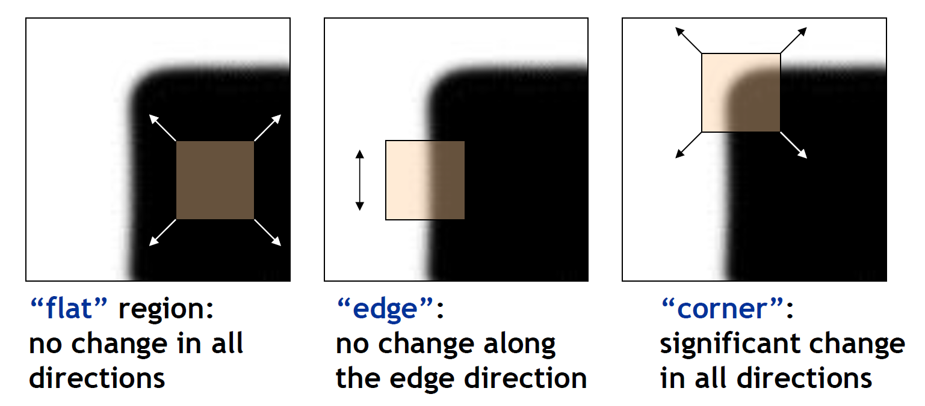
角点检测（Corner Detection)
角点

Slide 25
角点检测（Corner Detection)
角点

Slide 26
如何区分三种类型的点？
平坦
边
角点

Slide 27
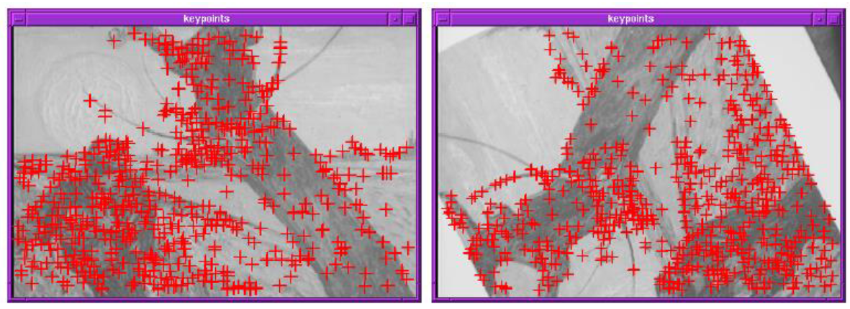
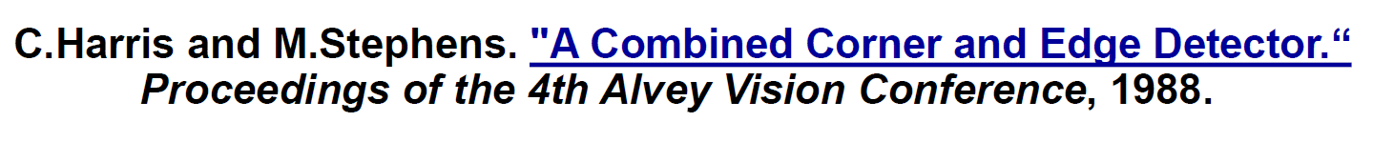
Harris
在角点处，沿任意方向运动都会引起像素颜色的明显变化
等价于：在角点附近，图像梯度具有至少两个主方向

Slide 28
Harris Detector Formulation
• Change of intensity for the shift [u,v]:
Sensory Augmented Computing Computer Vision
WS 14/15
Window function w(x,y) =
1 in window, 0 outside
or
Perceptual and
Gaussian
36
Slide credit: Rick Szeliski
B. Leibe

Slide 29
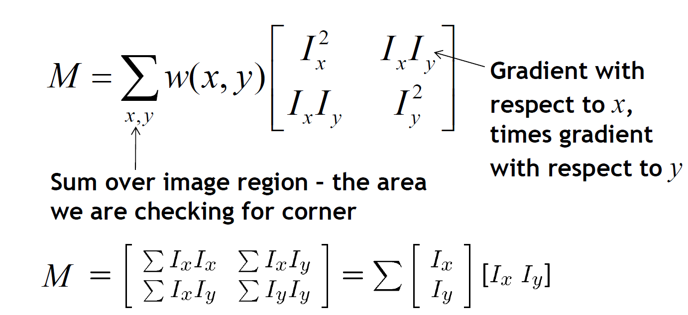
Harris Detector Formulation
• This measure of change can be approximated by:
where M is a 2×2 matrix computed from image
derivatives:
Sensory Augmented Computing Computer Vision
WS 14/15
Perceptual and
Slide credit: Rick Szeliski
B. Leibe

Slide 30
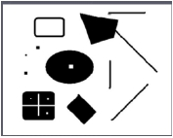
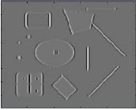
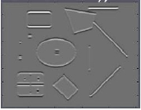
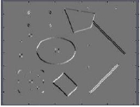
Harris Detector Formulation
Image I
Ix
Iy
IxIy
where M is a 2×2 matrix computed from image
derivatives:
Sensory Augmented Computing Computer Vision
WS 14/15
Perceptual and
38
Slide credit: Rick Szeliski
B. Leibe

Slide 31
What Does This Matrix Reveal?
• First, let’s consider an axis-aligned corner:
Sensory Augmented Computing Computer Vision
WS 14/15
Perceptual and
39
Slide credit: Kristen Grauman
B. Leibe

Slide 32
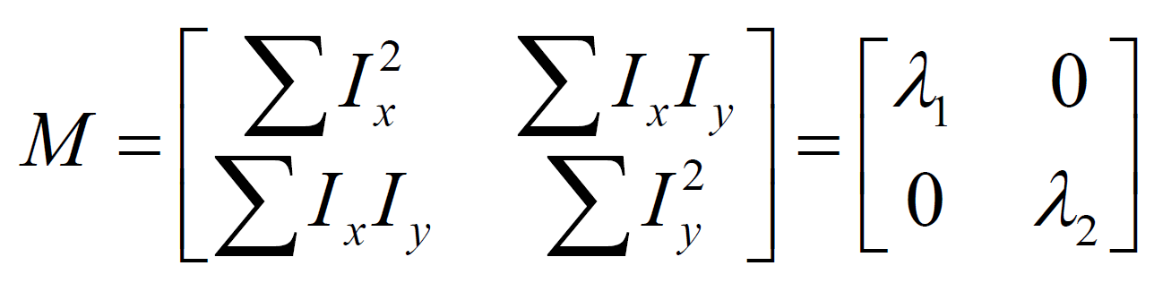
What Does This Matrix Reveal?
• First, let’s consider an axis-aligned corner:
• This means:
Sensory Augmented Computing Computer Vision
Dominant gradient directions align with x or y axis
If either λ is close to 0, then this is not a corner, so look for
WS 14/15
➢
➢
locations where both are large.
• What if we have a corner that is not aligned with the
image axes?
Perceptual and
40
Slide credit: David Jacobs
B. Leibe

Slide 33
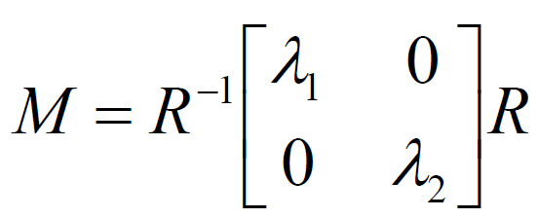
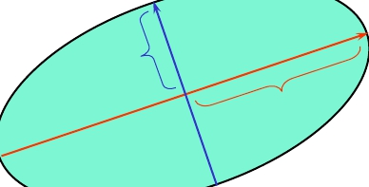
General Case
• Since M is symmetric, we have
(Eigenvalue decomposition)
• We can visualize M as an ellipse with axis lengths
determined by the eigenvalues and orientation
determined by R
Direction of the
slowest change
Direction of the
fastest change
Sensory Augmented Computing Computer Vision
WS 14/15
λmin
λmax
Perceptual and
41
adapted from Darya Frolova, Denis Simakov
Slide credit: Kristen Grauman
B. Leibe

Slide 34
Interpreting the Eigenvalues
• Classification of image points using eigenvalues of M:
λ2
“Edge”
λ2 >> λ1
“Flat”
region
“Corner”
λ1 and λ2 are large, λ1~ λ2;
E increases in all directions
“Edge”
λ1 >> λ2
Sensory Augmented Computing Computer Vision
WS 14/15
λ1 and λ2 are small;
E is almost constant
in all directions
Perceptual and
λ1
42
Slide credit: Kristen Grauman
B. Leibe

Slide 35
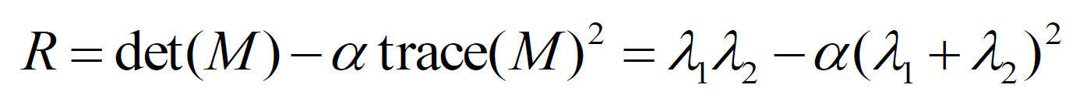
Corner Response Function
λ2
“Edge”
R <0
“Corner”
R >0
• Fast approximation
Sensory Augmented Computing Computer Vision
WS 14/15
➢
Avoid computing the
eigenvalues
α: constant
(0.04 to 0.06)
“Flat”
region
“Edge”
R <0
Perceptual and
➢
λ1
43
Slide credit: Kristen Grauman
B. Leibe

Slide 37
Summary: Harris Detector [Harris88]
Sensory Augmented Computing Computer Vision
WS 14/15
Perceptual and
Slide credit: Krystian Mikolajczyk

Slide 38
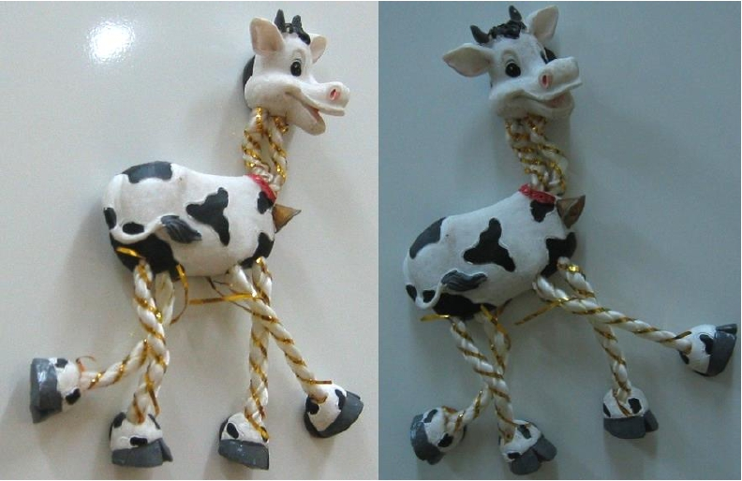
Harris Detector: Workflow
Sensory Augmented Computing Computer Vision
WS 14/15
Perceptual and
46
Slide adapted from Darya Frolova, Denis Simakov
B. Leibe

Slide 39
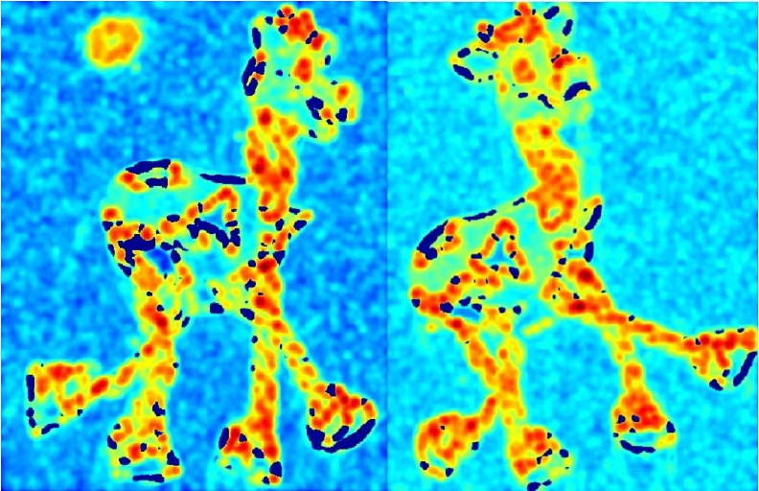
Harris Detector: Workflow
Sensory Augmented Computing Computer Vision
WS 14/15
Perceptual and
• Compute corner responses R
B. Leibe
47
Slide adapted from Darya Frolova, Denis Simakov

Slide 40
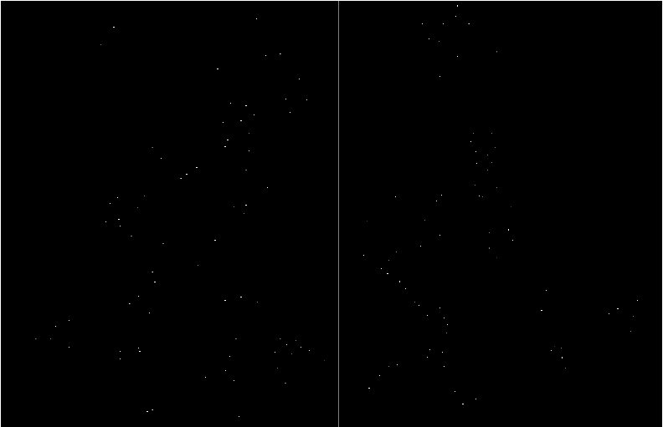
Harris Detector: Workflow
Sensory Augmented Computing Computer Vision
WS 14/15
Perceptual and
• Take only the local maxima of R, where R > threshold.
B. Leibe
48
Slide adapted from Darya Frolova, Denis Simakov

Slide 41
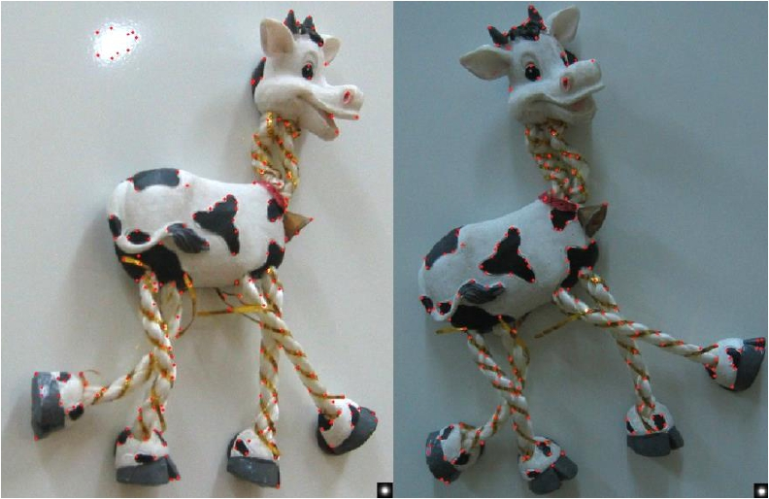
Harris Detector: Workflow
Sensory Augmented Computing Computer Vision
WS 14/15
Perceptual and
• Resulting Harris points
Slide adapted from Darya Frolova, Denis Simakov
49
B. Leibe

Slide 42
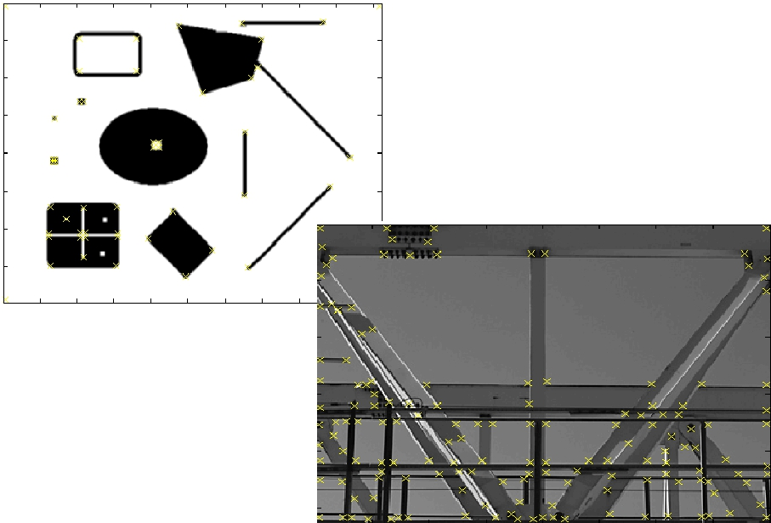
Harris Detector – Responses [Harris88]
Sensory Augmented Computing Computer Vision
WS 14/15
Effect: A very precise
corner detector.
Perceptual and
50
Slide credit: Krystian Mikolajczyk

Slide 43
Harris Detector – Responses [Harris88]
Sensory Augmented Computing Computer Vision
WS 14/15
Perceptual and
51
Slide credit: Krystian Mikolajczyk

Slide 44
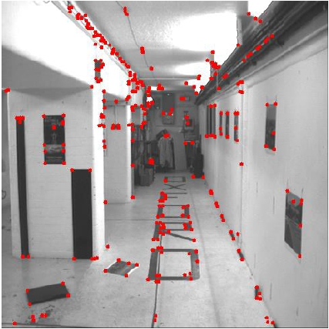
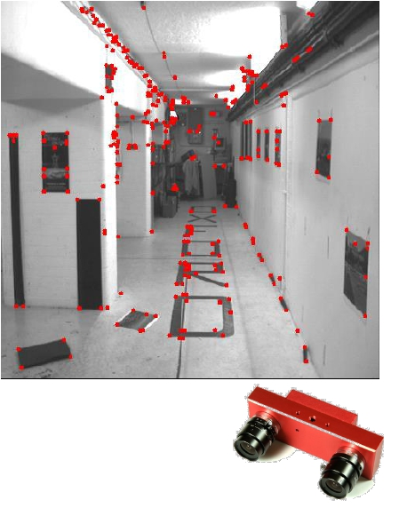
Harris Detector – Responses [Harris88]
Sensory Augmented Computing Computer Vision
WS 14/15
Perceptual and
• Results are well suited for finding stereo
correspondences
52
Slide credit: Kristen Grauman

Slide 45
Harris对光照变化和几何变换的稳定性？

Slide 46
Rotation invariance?
Ellipse rotates but its shape (i.e.
eigenvalues) remains the same
Corner response R is invariant to image rotation
Sensory Augmented Computing Computer Vision
WS 14/15
Perceptual and
53
Slide credit: Kristen Grauman
B. Leibe

Slide 47
Scale invariance?
Sensory Augmented Computing Computer Vision
WS 14/15
Corner
All points will be
classified as edges!
Not invariant to image scale!
Perceptual and
54
Slide credit: Kristen Grauman
B. Leibe

Slide 48
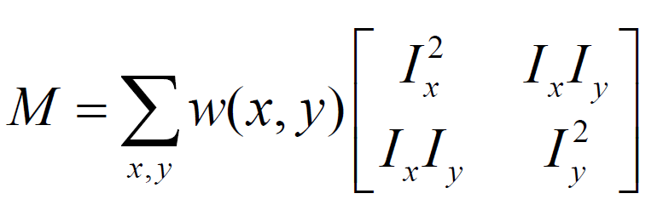
Illumination invariance?
Sensory Augmented Computing Computer Vision
Use only gradient
WS 14/15
Invariant to additive changes!
Perceptual and
54
Slide credit: Kristen Grauman
B. Leibe

Slide 49
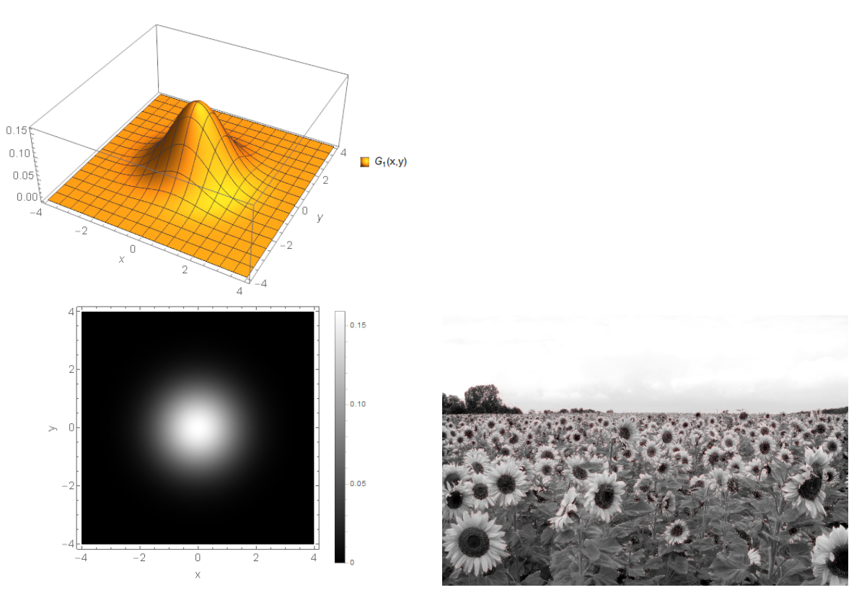
斑点检测（Blob Detection)
斑点

Slide 50
斑点检测（Blob Detection)
斑点

Slide 51
斑点有何特征？

Slide 52
斑点有何特征？
0
1
0
1
1
1
1
-4
1
1
-8
1
0
1
0
1
1
1

Slide 53
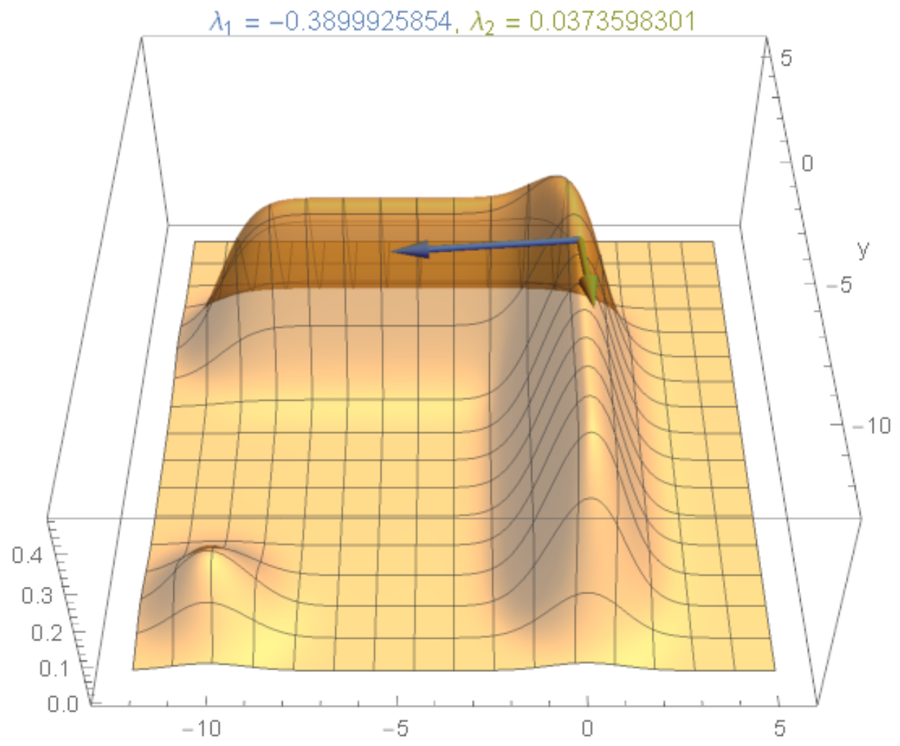
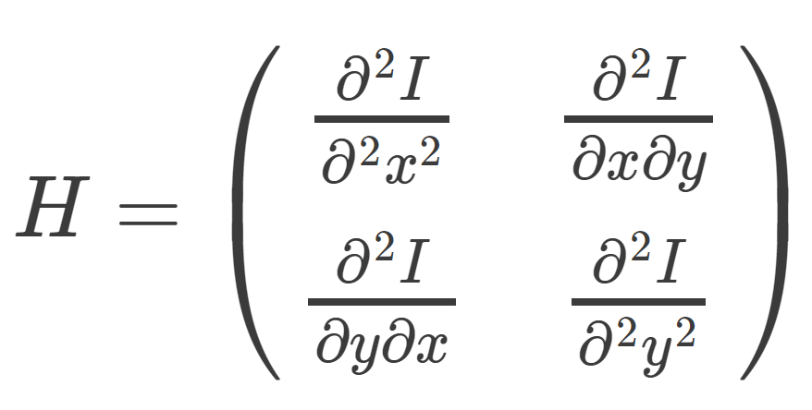

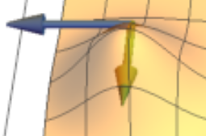
图像（二维函数）的Hessian矩阵

Slide 54
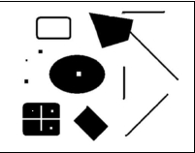
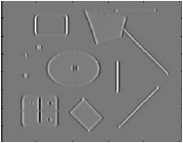
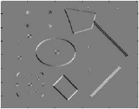
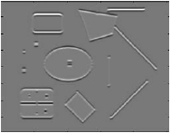
Hessian Detector
• Hessian determinant
[Beaudet78]
Ixx
⎡Ixx
⎣Ixy
Ixy⎤
I yy⎥
Hessian(I) =
Intuition: Search for strong
derivatives in two
orthogonal directions
Slide credit: Krystian Mikolajczyk
Ixy
B. Leibe
Iyy
Sensory Augmented Computing Computer Vision
WS 14/15
Perceptual and
55

Slide 55
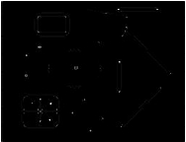
Hessian Detector
• Hessian determinant
[Beaudet78]
Ixx
Ixy
⎡Ixx
⎣Ixy
Ixy⎤
I yy⎥
Hessian(I) =
Iyy
Sensory Augmented Computing Computer Vision
WS 14/15
Perceptual and
Slide credit: Krystian Mikolajczyk
56
B. Leibe

Slide 56
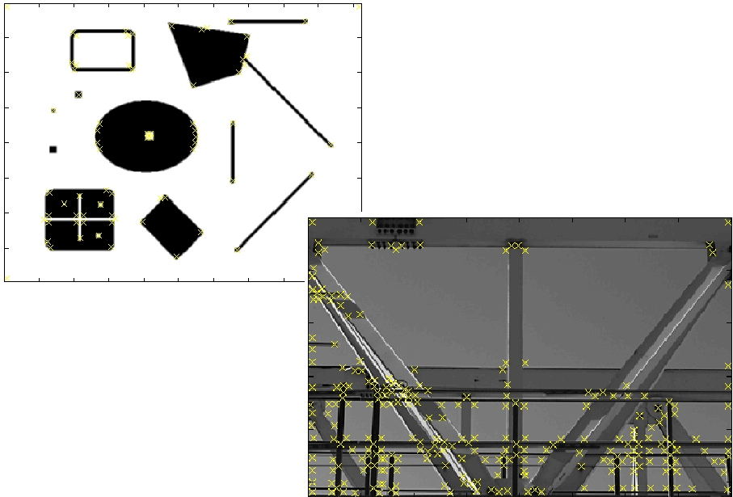
Hessian Detector – Responses [Beaudet78]
Sensory Augmented Computing Computer Vision
WS 14/15
Effect: Responses mainly
on corners and strongly
textured areas.
Perceptual and
57
Slide credit: Krystian Mikolajczyk

Slide 57
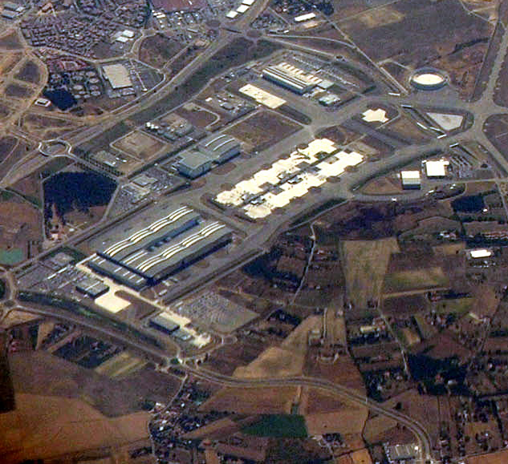

Hessian Detector – Responses [Beaudet78]
Sensory Augmented Computing Computer Vision
WS 14/15
Perceptual and
58
Slide credit: Krystian Mikolajczyk

Slide 58
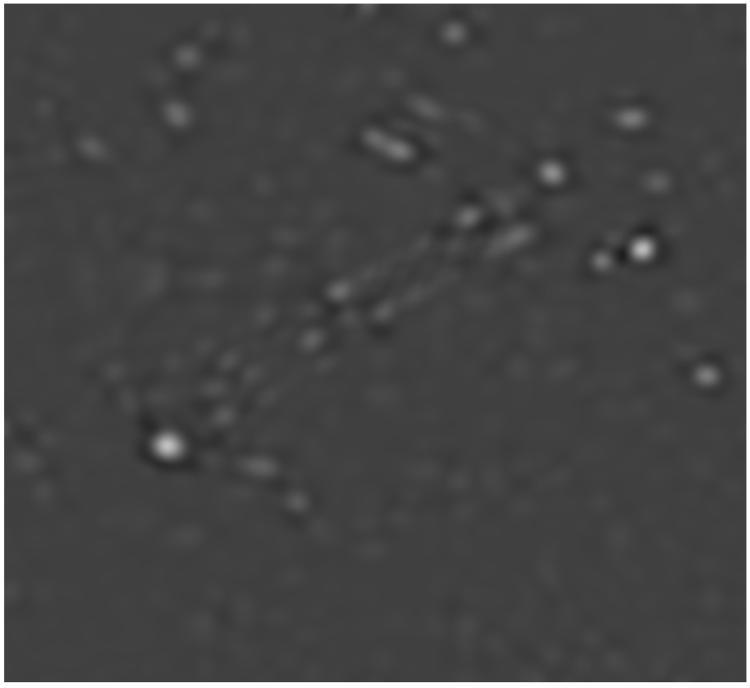
Hessian Detector – Responses [Beaudet78]
Sensory Augmented Computing Computer Vision
WS 14/15
Perceptual and
58
Slide credit: Krystian Mikolajczyk

Slide 59
Hessian对光照变化和几何变换的稳定性？

Slide 60
如何实现“尺度不变”？

Slide 61
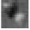



尺度空间与图像金字塔 (Image Pyramid)
低
大
分辨率
尺度
高
小

Slide 62

How Should We Go About Resampling?
Let’s resample the
checkerboard by taking
one sample at each
circle.
In the top left board, the
new representation is
reasonable. Top right
also yields a reasonable
representation.
Bottom left is all black
(dubious) and bottom
right has checks that are
too big.
Sensory Augmented Computing Computer Vision
WS 14/15
Perceptual and
59
Image Source: Forsyth & Ponce
B. Leibe

Slide 63

Aliasing in Graphics
Sensory Augmented Computing Computer Vision
WS 14/15
Perceptual and
65
Image Source: Alexej Efros
B. Leibe

Slide 64


Resampling with Prior Smoothing
• Note: We cannot recover the high frequencies, but we
can avoid artifacts by smoothing before resampling.
Sensory Augmented Computing Computer Vision
WS 14/15
Perceptual and
66
Image Source: Forsyth & Ponce
B. Leibe

Slide 65

The Gaussian Pyramid
Low resolution
G4 =(G3*gaussian)↓2
blur
blur
blur
G0 =Image
blur
G3 =(G2*gaussian)↓2
G2 =(G1*gaussian)↓2
G1 =(G0*gaussian)↓2
Sensory Augmented Computing Computer Vision
WS 14/15
Perceptual and
High resolution
67
Source: Irani & Basri
B. Leibe

Slide 66

Gaussian Pyramid – Stored Information
All the extra
levels add very
little overhead
for memory or
computation!
Sensory Augmented Computing Computer Vision
WS 14/15
Perceptual and
68
Source: Irani & Basri
B. Leibe

Slide 67
Gaussian Pyramid: Summary
• Construction: create each level from previous one
➢
Smooth and sample
• Smooth with Gaussians, in part because
➢
➢
a Gaussian*Gaussian = another Gaussian
G(σ1) * G(σ2) = G(sqrt(σ1 2 + σ2 2))
• Gaussians are low-pass filters, so the representation is
redundant once smoothing has been performed.
⇒ There is no need to store smoothed images at the
full original resolution.
Sensory Augmented Computing Computer Vision
WS 14/15
Perceptual and
69
Slide credit: David Lowe
B. Leibe

Slide 68

The Laplacian Pyramid
Li = Gi − expand(Gi+1)
Gi = Li + expand(Gi+1)
Gaussian Pyramid
Gn
Laplacian Pyramid
Ln =Gn
G2
G1
-
-
L2
=
=
L1
G0
Sensory Augmented Computing Computer Vision
WS 14/15
L0
-
=
Perceptual and
Why is this useful?
B. Leibe
70
Source: Irani & Basri

Slide 69




Laplacian ~ Difference of Gaussian
-
=
DoG = Difference of Gaussians
Cheap approximation – no derivatives needed.
Sensory Augmented Computing Computer Vision
WS 14/15
-
=
Perceptual and
71
B. Leibe

Slide 70


Laplacian 图像分解&重建
分解
重建

Slide 71

Laplacian图像融合
1. 构造Laplacian金字塔
2. 在金字塔的每一层进行融合
3. 用融合后的金字塔进行重建
https://docs.opencv.org/3.1.0/dc/dff/tutorial_py_pyramids.html

Slide 72
实现“尺度不变”？
尺度相关：在某一尺度上不是特征点的位置，在其它尺度上可能是特征点

Slide 73
实现“尺度不变”？
在不同尺度同时进行检测与匹配

Slide 74

Naïve Approach: Exhaustive Search
• Multi-scale procedure
➢
Compare descriptors while varying the patch size
Sensory Augmented Computing Computer Vision
WS 14/15
fA
e.g. color
Similarity
measure
d( fA, fB)
B. Leibe
fB
e.g. color
≠
Perceptual and
62
Slide credit: Krystian Mikolajczyk

Slide 75

Naïve Approach: Exhaustive Search
• Multi-scale procedure
➢
Compare descriptors while varying the patch size
Sensory Augmented Computing Computer Vision
WS 14/15
fA
e.g. color
Similarity
measure
d( fA, fB)
B. Leibe
fB
e.g. color
≠
Perceptual and
63
Slide credit: Krystian Mikolajczyk

Slide 76

Naïve Approach: Exhaustive Search
• Multi-scale procedure
➢
Compare descriptors while varying the patch size
Sensory Augmented Computing Computer Vision
WS 14/15
fA
e.g. color
Similarity
measure
d( fA, fB)
B. Leibe
fB
e.g. color
=
Perceptual and
64
Slide credit: Krystian Mikolajczyk

Slide 77

Naïve Approach: Exhaustive Search
• Comparing descriptors while varying the patch size
➢
➢
➢
Computationally inefficient
Inefficient but possible for matching
Prohibitive for retrieval in large
databases
e.g. color
➢
Prohibitive for recognition
e.g. color
e.g. color
Sensory Augmented Computing Computer Vision
WS 14/15
fA
e.g. color
Similarity
measure
d( fA, fB)
B. Leibe
fB
e.g. color
=
Perceptual and
65
Slide credit: Krystian Mikolajczyk

Slide 78


Automatic Scale Selection
• Solution:
➢
➢
Design a function on the region, which is “scale invariant”
(the same for corresponding regions, even if they are at
different scales)
Example: average intensity. For corresponding
regions (even of different sizes) it will be the same.
For a point in one image, we can consider it as a function of
region size (patch width)
Sensory Augmented Computing Computer Vision
WS 14/15
f
Image 1
f
Image 2
scale = ½
Perceptual and
Region size
Slide credit: Kristen Grauman
Region size
66
B. Leibe

Slide 79


Automatic Scale Selection
• Common approach:
➢
➢
Take a local maximum of this function.
Observation: region size for which the maximum is achieved
should be invariant to image scale.
Important: this scale invariant region size is
found in each image independently!
Sensory Augmented Computing Computer Vision
WS 14/15
f
Image 1
f
Image 2
scale = ½
s2 = ½ s1
Perceptual and
s1 Region size
Slide credit: Kristen Grauman
s2
Region size
67
B. Leibe

Slide 80


Automatic Scale Selection
• Function responses for increasing scale (scale signature)
Sensory Augmented Computing Computer Vision
WS 14/15
Perceptual and
f (Ii1😐im(x,σ))
Slide credit: Krystian Mikolajczyk
f (Ii1😐im(x′,σ))
68
B. Leibe

Slide 81


Automatic Scale Selection
• Function responses for increasing scale (scale signature)
Sensory Augmented Computing Computer Vision
WS 14/15
Perceptual and
f (Ii1😐im(x,σ))
Slide credit: Krystian Mikolajczyk
f (Ii1😐im(x′,σ))
69
B. Leibe

Slide 82



Automatic Scale Selection
• Function responses for increasing scale (scale signature)
Sensory Augmented Computing Computer Vision
WS 14/15
Perceptual and
f (Ii1😐im(x,σ))
Slide credit: Krystian Mikolajczyk
f (Ii1😐im(x′,σ))
70
B. Leibe

Slide 83


Automatic Scale Selection
• Function responses for increasing scale (scale signature)
Sensory Augmented Computing Computer Vision
WS 14/15
Perceptual and
f (Ii1😐im(x,σ))
Slide credit: Krystian Mikolajczyk
f (Ii1😐im(x′,σ))
71
B. Leibe

Slide 84

Automatic Scale Selection
• Function responses for increasing scale (scale signature)
Sensory Augmented Computing Computer Vision
WS 14/15
Perceptual and
f (Ii1😐im(x,σ))
Slide credit: Krystian Mikolajczyk
f (Ii1😐im(x′,σ))
72
B. Leibe

Slide 85

Automatic Scale Selection
• Function responses for increasing scale (scale signature)
Sensory Augmented Computing Computer Vision
WS 14/15
Perceptual and
f (Ii1😐im(x,σ))
Slide credit: Krystian Mikolajczyk
f (Ii1😐im(x′,σ′))
73
B. Leibe

Slide 86

Automatic Scale Selection
• Normalize: Rescale to fixed size
Sensory Augmented Computing Computer Vision
WS 14/15
f (Ii1😐im(x,σ))
f (Ii1😐im(x′,σ′))
Perceptual and
74
Slide credit: Tinne Tuytelaars
B. Leibe

Slide 87






What Is A Useful Signature Function?
• Laplacian-of-Gaussian = “blob” detector
Sensory Augmented Computing Computer Vision
WS 14/15
Perceptual and
75
B. Leibe

Slide 88

Characteristic Scale
• We define the characteristic scale as the scale that
produces peak of Laplacian response
Characteristic scale
Sensory Augmented Computing Computer Vision
WS 14/15
Perceptual and
76
Slide credit: Svetlana Lazebnik

Slide 89







Laplacian-of-Gaussian (LoG)
• Interest points:
➢ Local maxima in scale
space of Laplacian-of-
Gaussian
σ5
σ4
Lxx(σ)+Lyy(σ) σ3
σ2
σ
Sensory Augmented Computing Computer Vision
WS 14/15
Perceptual and
Slide adapted from Krystian Mikolajczyk
B. Leibe

Slide 90

Laplacian-of-Gaussian (LoG)
• Interest points:
➢ Local maxima in scale
space of Laplacian-of-
Gaussian
σ5
σ4
Lxx(σ)+Lyy(σ) σ3
σ2
σ
Sensory Augmented Computing Computer Vision
WS 14/15
Perceptual and
Slide adapted from Krystian Mikolajczyk
B. Leibe

Slide 91

Laplacian-of-Gaussian (LoG)
• Interest points:
➢ Local maxima in scale
space of Laplacian-of-
Gaussian
σ5
σ4
Lxx(σ)+Lyy(σ) σ3
σ2
σ
Sensory Augmented Computing Computer Vision
WS 14/15
Perceptual and
Slide adapted from Krystian Mikolajczyk
B. Leibe

Slide 92

Laplacian-of-Gaussian (LoG)
• Interest points:
➢ Local maxima in scale
space of Laplacian-of-
Gaussian
σ5
σ4
Lxx(σ)+Lyy(σ) σ3
σ2
⇒ List of (x, y, σ)
σ
Sensory Augmented Computing Computer Vision
WS 14/15
Perceptual and
Slide adapted from Krystian Mikolajczyk
B. Leibe

Slide 93

Difference-of-Gaussian (DoG)
• We can efficiently approximate the Laplacian with a
difference of Gaussians:
L =σ 2(Gxx(x, y,σ)+Gyy(x, y,σ))
(Laplacian)
DoG =G(x, y,kσ)−G(x, y,σ)
(Difference of Gaussians)
Sensory Augmented Computing Computer Vision
WS 14/15
Perceptual and
84
B. Leibe

Slide 94

Difference-of-Gaussian (DoG)
• Difference of Gaussians as approximation of the LoG
➢
This is used e.g. in Lowe’s SIFT pipeline
for feature detection.
• Advantages
➢
➢
No need to compute 2nd derivatives
Gaussians are computed anyway, e.g.
in a Gaussian pyramid.
Sensory Augmented Computing Computer Vision
WS 14/15
-
=
Perceptual and
85
B. Leibe

Slide 95

Key point localization with DoG
• Detect maxima of
difference-of-Gaussian
(DoG) in scale space
• Then reject points with
low contrast (threshold)
• Eliminate edge responses
Resample
Blur
Subtract
Sensory Augmented Computing Computer Vision
WS 14/15
Candidate keypoints:
Perceptual and
list of (x,y,σ)
Slide credit: David Lowe

Slide 96

Results
Sensory Augmented Computing Computer Vision
WS 14/15
Perceptual and
88
B. Leibe

Slide 97

Results
Sensory Augmented Computing Computer Vision
WS 14/15
Perceptual and
88
B. Leibe

Slide 98
阅读文献
David G. Lowe, Distinctive Image Features from Scale-Invariant Keypoints, IJCV2004. 第3、4章

Slide 99

实现“仿射不变”？
…

Slide 100

实现“仿射不变”？
…

